Slide 1


5 Game Ideas

Slide 2
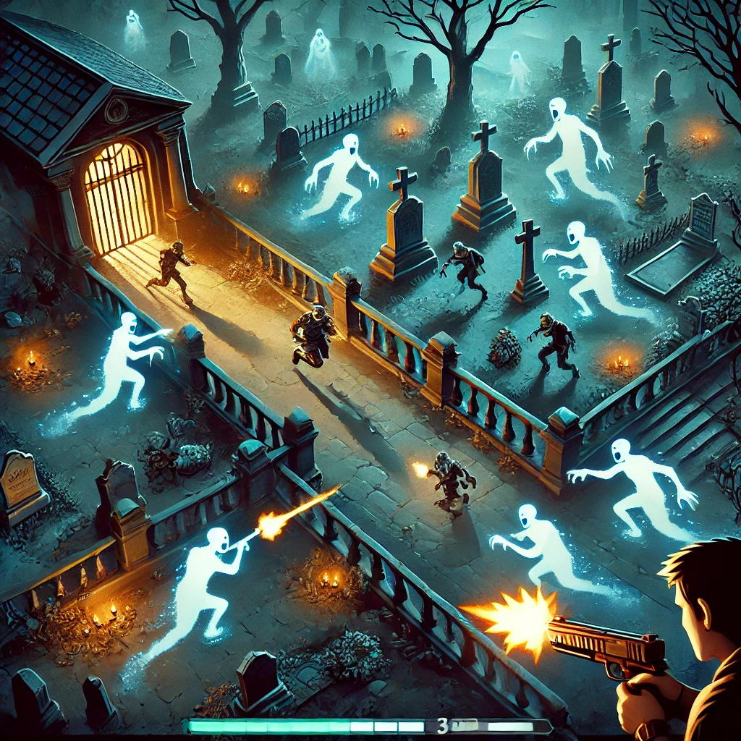
Phantom Blaster
Concept:
A fast-paced action game where players battle hordes of ghosts and zombies while dodging obstacles in a haunted graveyard.
Notable Features:
- Dynamic shooting mechanic with weapon upgrades.
- Challenging environmental hazards.
- Variety of enemies and power-ups.
- Score multiplier for combos and survival.
Genre: Top-down action shooter
Target Audience: Arcade-style action game fans, zombie and ghost enthusiasts.

Slide 3

Neck Up!
Concept:
An action-packed platformer where a quirky giraffe grows its neck by eating apples while avoiding dangerous trees.
Notable Features:
- Variety of trees with good and bad apples.
- Increasing difficulty with faster and more complex patterns.
- Power-ups like 'Apple Magnet' and 'Time Freeze'.
- Boss trees with unique challenges.
Genre: Action/Platformer with Puzzle Elements
Target Audience: Casual gamers who enjoy light-hearted platformers.

Slide 4
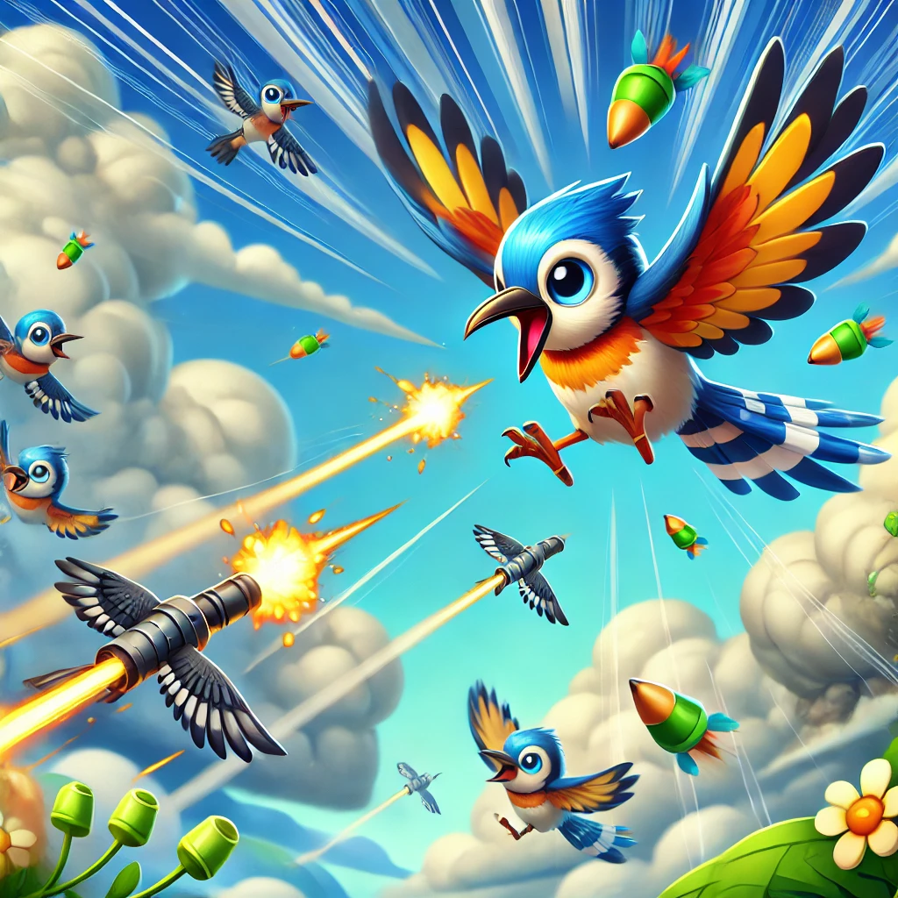
Seedstrike
Concept:
A side-scrolling aerial shooter where a brave bird defends its territory from enemy flocks using seed projectiles.
Notable Features:
- Unique shooting mechanics with various projectiles.
- Dynamic enemy types and environmental hazards.
- Power-ups and collectible upgrades.
- Customization options for bird characters.
Genre: Side-scrolling shooter
Target Audience: Action-packed game fans, younger audiences.

Slide 5
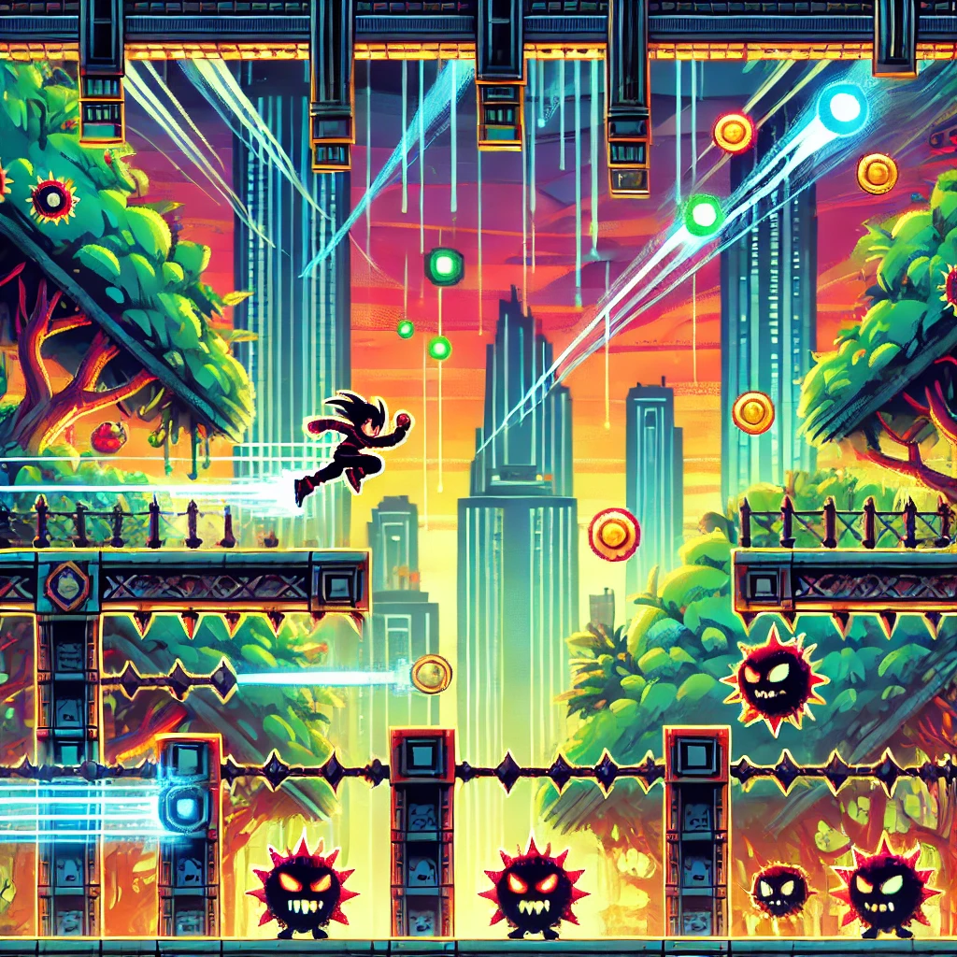
Jumpfinity
Concept:
An endless platformer where players navigate obstacles and enemies by jumping, sliding, and dodging.
Notable Features:
- Dynamic obstacles and enemy types.
- Power-ups like invincibility and double jumps.
- Endless gameplay with increasing difficulty.
- Achievements and high score tracking.
Genre: Side-scrolling platformer/endless runner
Target Audience: Gamers who enjoy reflex-based challenges and fast-paced gameplay.

Slide 6
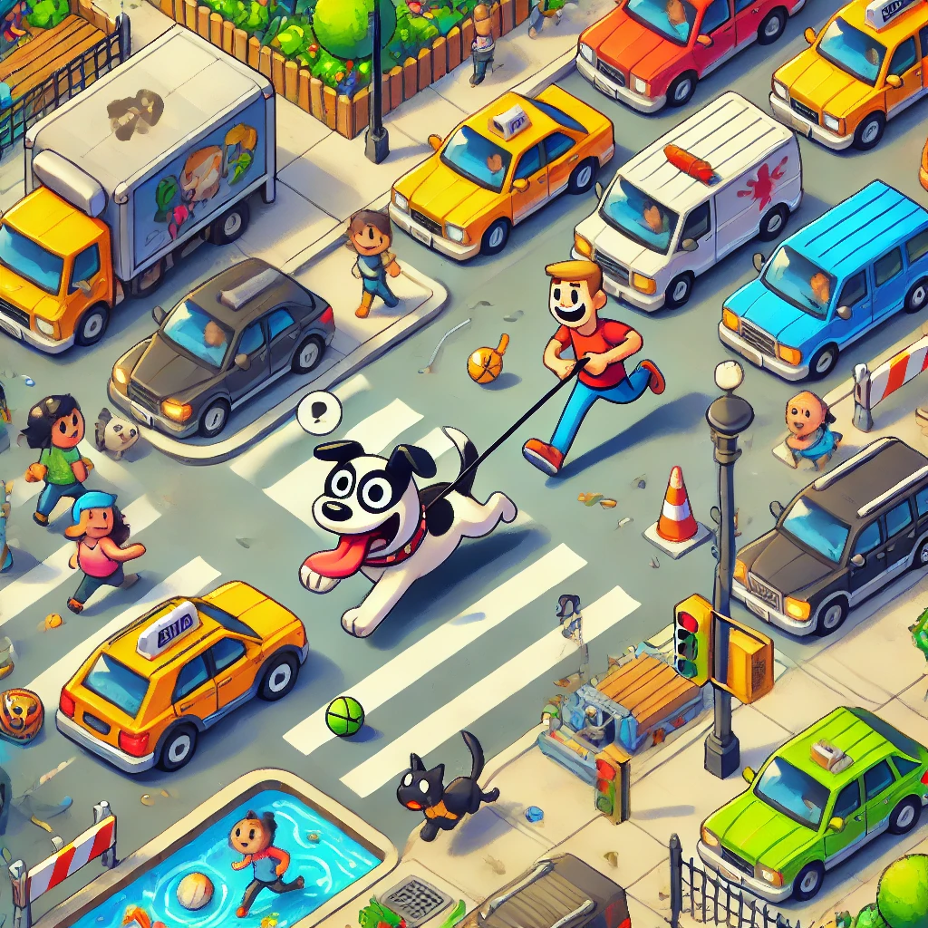
Pawstacle Dash
Concept:
A top-down game where players walk an energetic dog through a bustling city filled with dynamic obstacles.
Notable Features:
- Dynamic dog behavior adds humor and complexity.
- Varied city obstacles and environmental hazards.
- Power-ups like dog treats and tennis balls.
- Multiple neighborhoods with distinct challenges.
Genre: Top-down action/obstacle navigation
Target Audience: Casual gamers, dog lovers, and families.

Slide 7

THANK YOU

